Slide 1
Welcome to Parent
Literacy Night!
Presented by
Robert Coleman, District Supervisor of Literacy and Humanities K-12
Lindsay Barna, Keith Chiappone, Alice Haight, and Jennifer Resil-Johnson

Slide 2
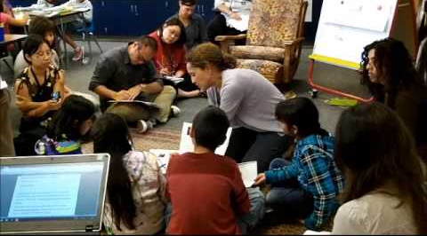
A Window into Reading/Writing Workshop
in Middle School

Slide 3
Philosophy and Goals

Slide 4
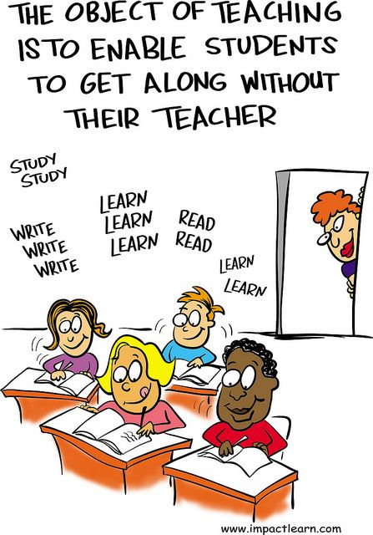
INDEPENDENCE
Students become independent readers and writers. This prepares them for life and career, for life-long learning and the ability to navigate and succeed in the world.
This is fostered in the classroom through:
-Goal-setting
-Managing work-period (planning for, what to do when “I’m done”)
-Understanding and applying learned strategies

Slide 5
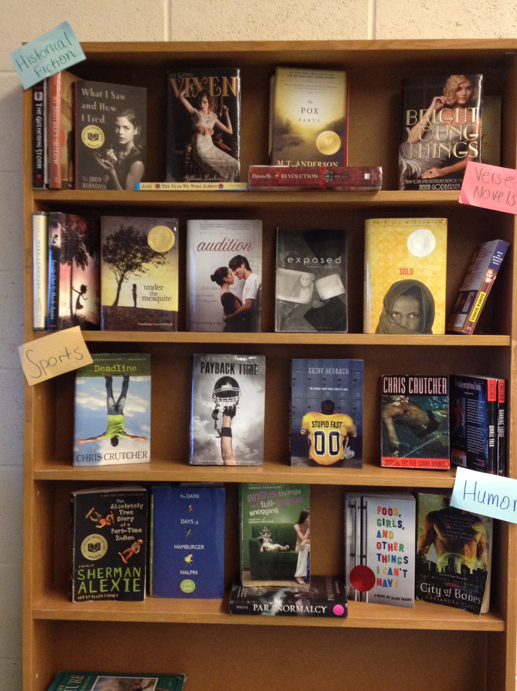
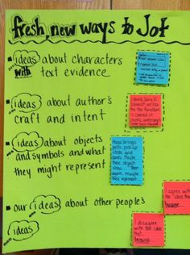
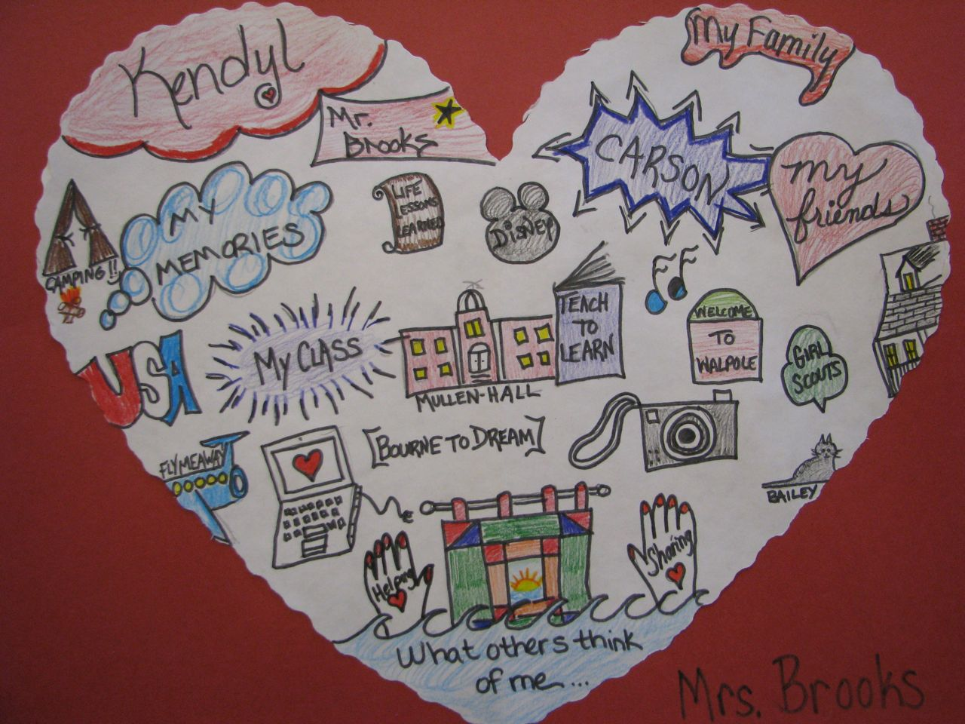
CHOICE
Giving students choice over what they write and
read engages them and makes them responsible
for their learning.
Giving students choice prepares them for making choices later on in their lives, choices that will hopefully be happy and rewarding.

Slide 6
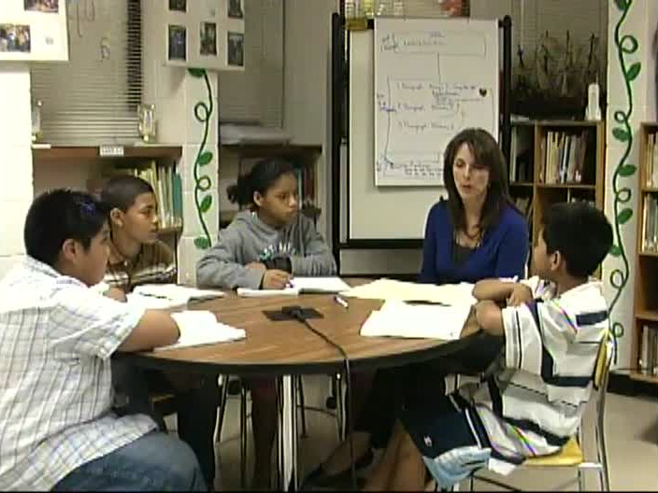
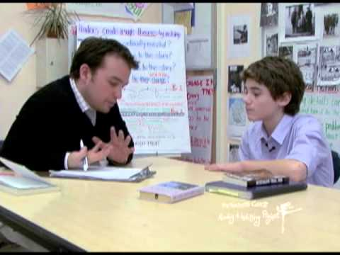
DIFFERENTIATION
Students read and write at their levels. Teachers work strategically to move them forward in their reading and writing.
This is done in small groups and individual conferences.

Slide 7
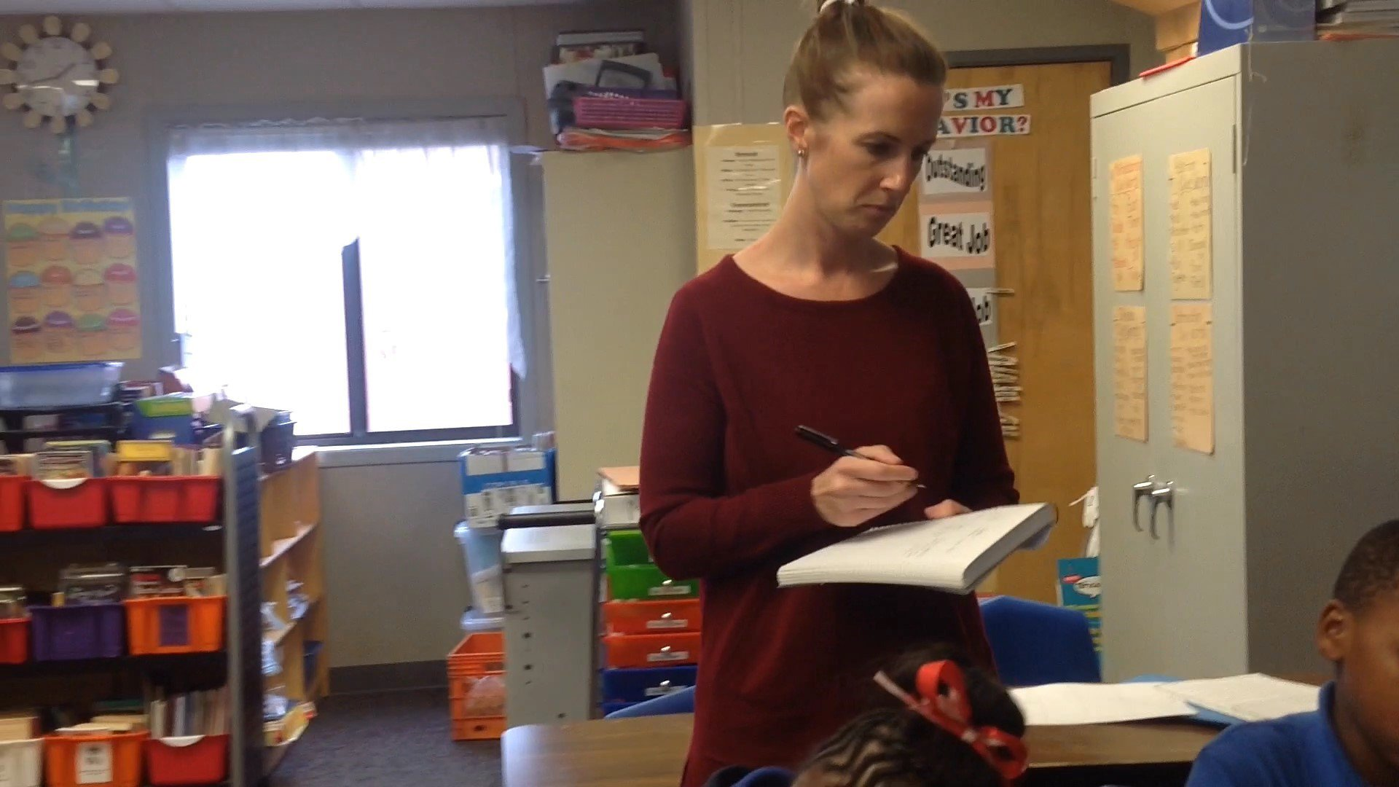
DIFFERENTIATION (Continued)
Teachers use information they’ve gathered on student progress to inform instructional decisions.
Using learning progressions and rubrics, aligned to our curriculum, teachers determine where students are in the learning process and what steps are needed to advance understanding.

Slide 8
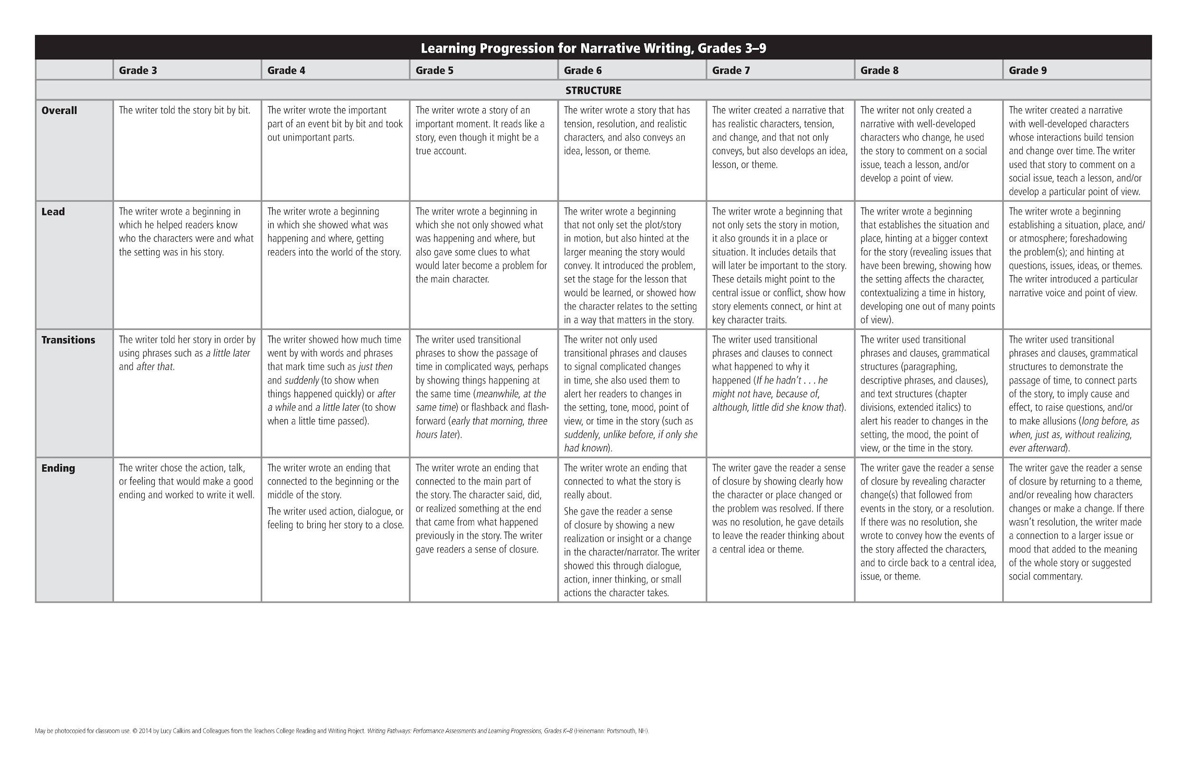
DIFFERENTIATION (Continued)
A Learning Progression is a
road or pathway students
travel as they progress
towards mastery.

Slide 9
DIFFERENTIATION (Continued)
Let’s take a closer look at the Learning Progression for Leads (Introductions) in Narrative Writing:
6th | 7th | 8th
The writer wrote a beginning that not only set the plot/story in motion, but also hinted at the larger meaning the story would convey. It introduced the problem, set the stage for the lesson that would be learned, or showed how the character relates to the setting in a way that matters in the story. | The writer wrote a beginning that not only sets the story in motion, it also grounds it in a place or situation. It includes details that will later be important to the story. These details might point to the central issue or conflict, show how story elements connect, or hint at key character traits. | The writer wrote a beginning that establishes the situation and place, hinting at a bigger context for the story (revealing issues that have been brewing, showing how the setting affects the character, contextualizing a time in history, developing one out of many points of view).

Slide 10
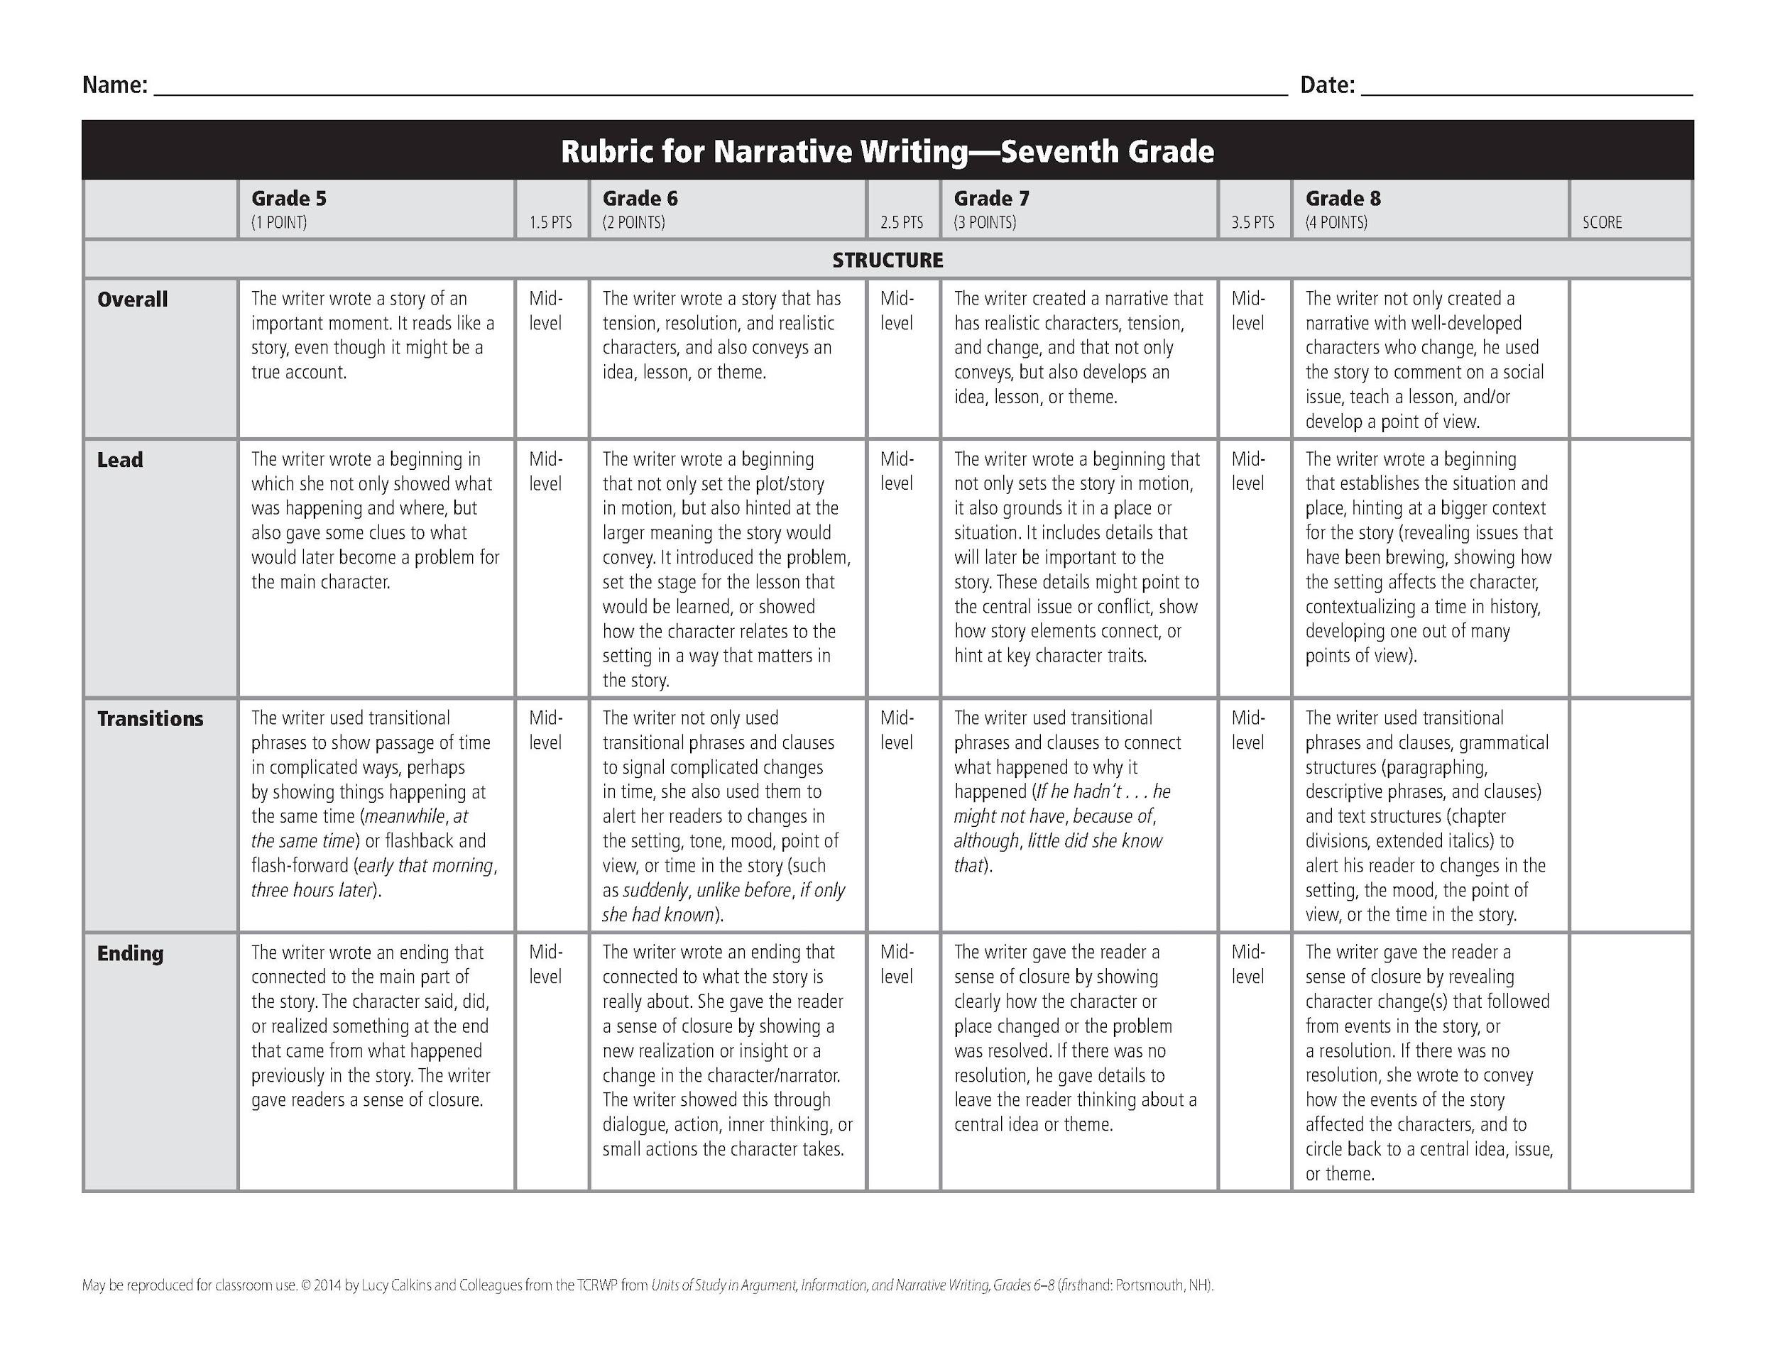
DIFFERENTIATION (Continued)
Rubrics use the same content and language, but add a point value to each descriptor.

Slide 11
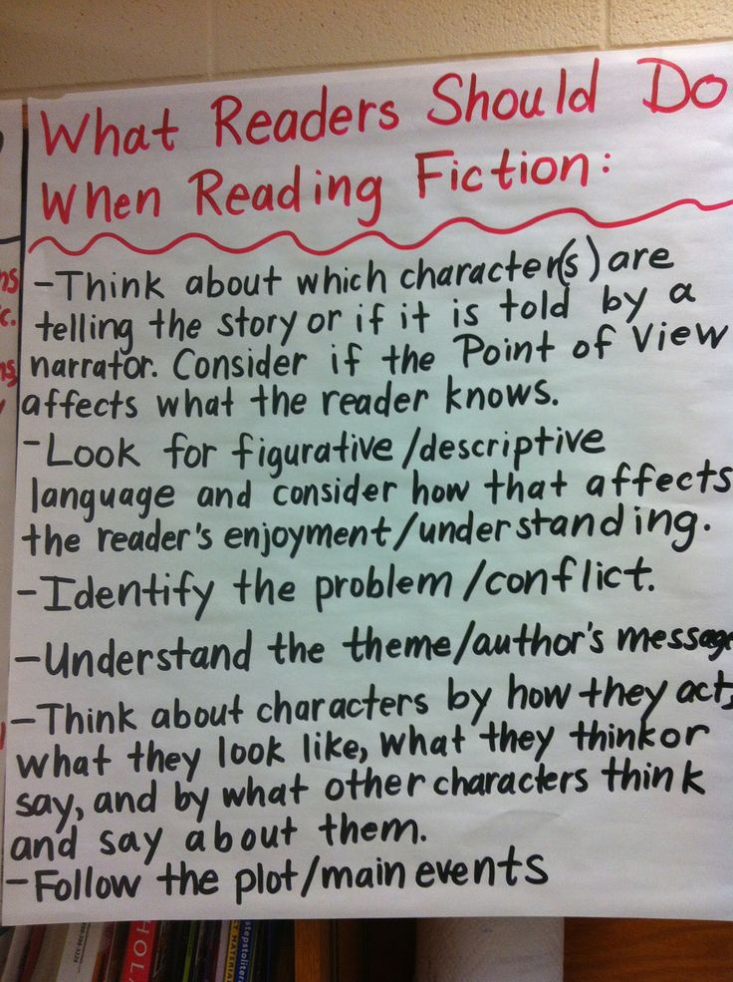
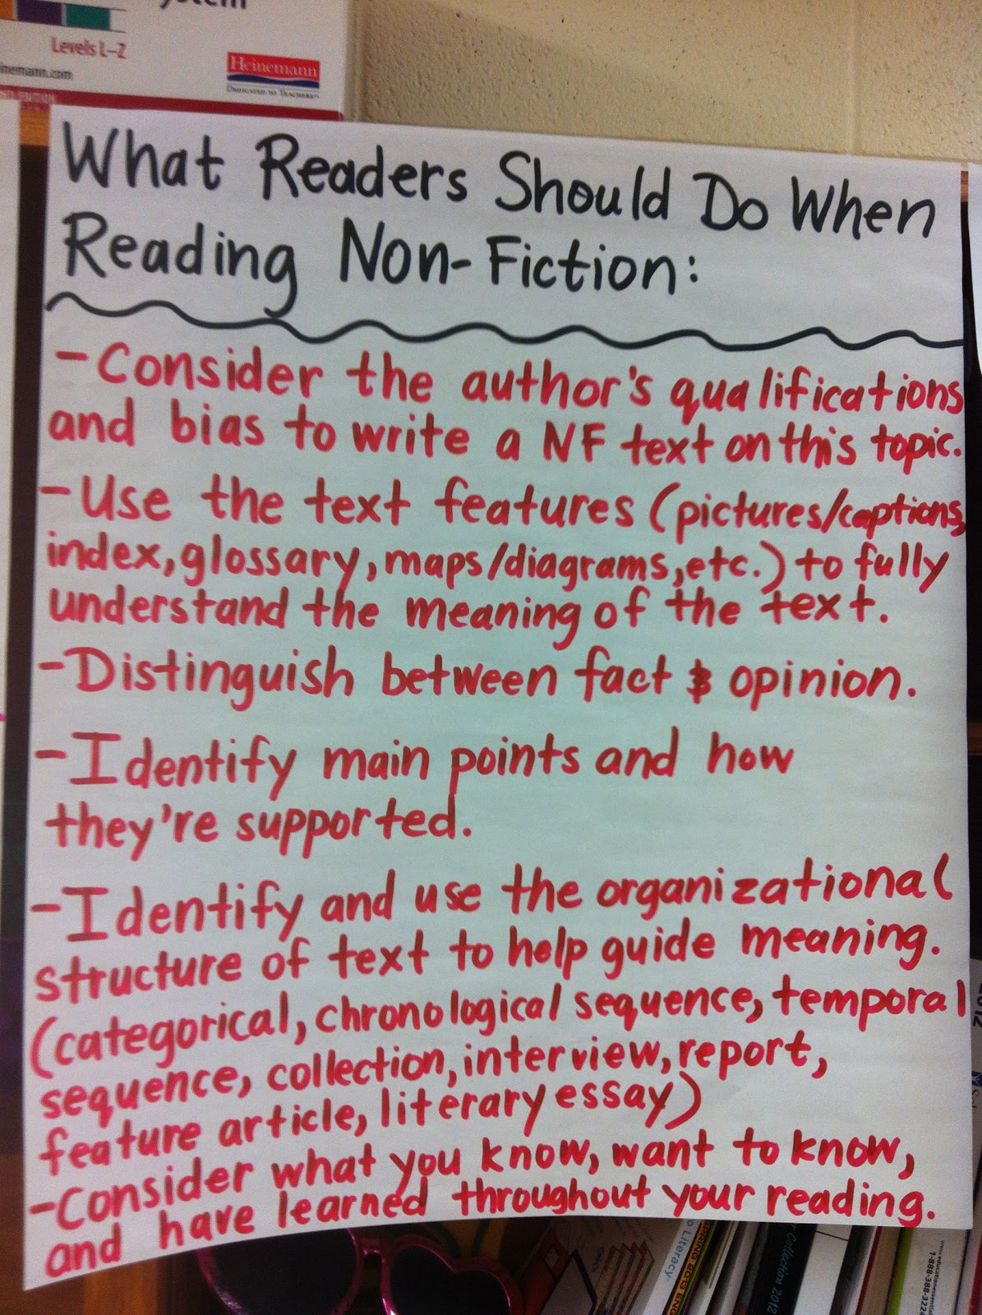
TEACH THE READER! TEACH THE WRITER!
Our goal is to create life-long readers, writers, and thinkers…informed, responsible and happy citizens and people.
The content taught in middle school literacy classroom has shifted.

Slide 12
DATA
New York State ELA 2016 Assessment (PARCC alternative):
non TCRWP schools = 304
all TCRWP schools = 312
core TCRWP schools = 326

Slide 13
The right thing to do…
“You’ll know, therefore, that teachers’ involvement with the Reading and Writing Project is working if your students become powerful readers and writers who read and write for real reasons - to advocate for themselves and others, to deepen their own and others’ knowledge, to illuminate the lives they live and the world they are a part of.”
- Lucy Calkins
Director of the Teachers College Reading and Writing Project

Slide 14
Workshop Lesson Demonstration
Presented by Alice Haight

Slide 15
A Review of the
School Year
Presented by Jennifer Resil-Johnson

Slide 16
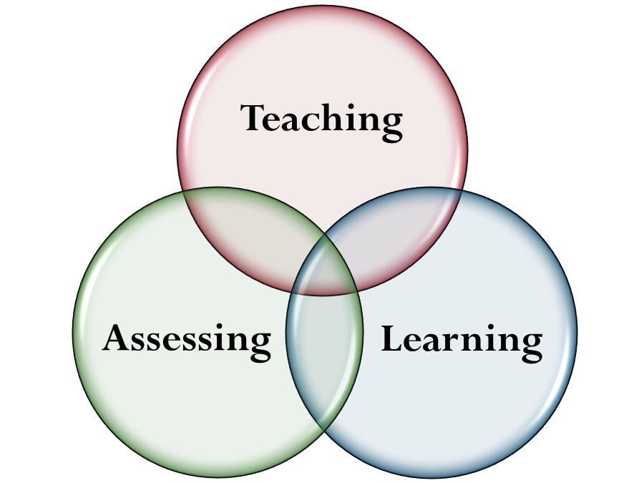
Assessments

Slide 17
Types of Assessment
Pre- and Post On-Demand Writings
Quarterlies
Various teacher-determined tests, quizzes, and projects
Formative Assessments:
-Observations during lessons, small group meetings, and conferences
-Review of student jots and notebook work
-Exit Tickets

Slide 18
INDEPENDENT READING AND ACCESS TO BOOKS
PRESENTED BY KEITH CHIAPPONE

Slide 19
“THE PATH TO LIFELONG READING HABITS DEPENDS ON INTERNALIZING A READING LIFESTYLE ALONG WITH READING SKILLS AND STRATEGIES.”
DONALYN MILLER, THE BOOK WHISPERER

Slide 20
THE CONFLICT: MORE LITERATE, BUT READING LESS?
There are more literate people in the United States than there have ever been before. However, more people are reading smaller pieces of text—brief news articles, text messages, social media updates, etc.
While people are actually reading more words than ever, they are also reading fewer books.
This is an opportunity for us as educators and parents to expose our children to literature that will speak to them in ways that stimulate their intellect.

Slide 21
QUESTION: WHO HAS SUPPORTED A CHILD WHO READ A BOOK THAT WAS:
Not interesting
Too hard
Too easy

Slide 22
INDEPENDENT READING AND ACCESS TO BOOKS
Students who love to read often can’t and lose interest because they are required to read books that:
Are not interesting
Are not relevant
Don’t answer questions about life and growing up
Students also lose interest in reading because:
They don’t see their parents reading
They have commitments to other, more immediately beneficial and time consuming activities (sports, art, etc).
They associate reading with school and not with their leisurely time.
They learn from teachers that they are judged on their current reading ability and not their actual growth throughout the year.

Slide 23
THE CONSEQUENCES OF WHOLE CLASS ASSIGNED READING STUDENTS WHO UNDERPERFORM CONTINUE TO DO SO BECAUSE…
They are in a constant state of “catching up” with no end in sight.
The social stigma of illiteracy perpetuates anxiety and further inability to perform.
AS A RESULT…
Students with deficient reading skills have higher absentee rates than those who do not.
Students with high absentee rates are more likely to drop out of high school. This results in a spiral of life-changing struggles that prevent future success.

Slide 24
THE BENEFITS OF INDEPENDENT READING
Students are given the choice to harness and control the pace at which they read and develop their comprehension skills.
Students are more likely to choose books that engage them.
Students are more likely to spend more of their leisurely time reading.
Students are more likely to engage in communal reading and book clubs not to pass a test, but to dive deeper into their books.
Students are able to forge peer groups of similar reading ability.
Students have the opportunity to explore different authors and genres that might not be included in the curriculum.

Slide 25
STRONG READERS:
Dedicate time to read
Self-select reading material
Share books and discuss what they are reading with other readers
Have reading plans and plan to read beyond their current book
Show preferences for genres, authors, and topics
“Research indicates that time spent reading correlates positively with students’ performance on standardized reading tests.”

Slide 26
WHAT ABOUT INSTRUCTION?
HOW STUDENTS ARE SCORED WITH INDEPENDENT BOOKS

Slide 27
WHAT ABOUT INSTRUCTION?
During reading workshops, students are taught about common ways that authors engage their readers.
Students are encouraged to look for author’s craft moves, make predictions, ask questions, and discover themes.
Each lesson is based on a theme-based skill that relates to all kinds of literature.
Students are then graded on a common assessment, such as a quarterly.

Slide 28
ACCESS TO BOOKS
WHERE ARE WE SUPPOSED TO GET ALL THESE BOOKS ANYWAY?

Slide 29
ALWAYS MONITOR YOUR CHILDREN’S IPAD USE WHILE THEY ARE READING.
ACCESS TO BOOKS SOME STUDENTS USE THE FOLLOWING WAYS TO ACCESS BOOKS:
Piscataway’s schools have a wide variety of books that students can borrow. Libraries are also able to send books to each other in the event that one library has a book that another one does not.
Piscataway school district students have access to Follett Shelf, an online library.
Free e-books are available on http://www.Gutenberg.org.
Amazon has a large collection of free e-books in their Kindle marketplace.

Slide 30
Response to Intervention:
Understanding Tier 1, 2, and 3

Slide 31
Response to Intervention
Tier 1 - all students
Tier 2 - some students (Tier 1 +Tier 2 instruction)
Tier 3 - fewer students (Tier 1 +Tier 2 +Tier 3 instruction)

Slide 32
Getting Ready for
High School

Slide 33
Independence, choice, complexity…
PARCC, PSAT, AP, SAT, ACT
College readiness
Informed Citizens, Happy Adults

Slide 34
How to Help
Students at Home

Slide 35
Let your student choose what to read.
Subscribe to magazines that will interest him or her.
Talk with your student about what s/he is reading.
Visit the library together.
Allow students to purchase books (at the bookstore, at rummage sales, from Scholastic Book Clubs) if possible.
Model that you, yourself, are a reader and writer.
Turn off the TV and talk about current and historical events.
Listen to audiobooks in the car.
Encourage your student to write about what interests him or her.
Ask for copies of genre rubrics and learning progressions that act as benchmarks for your student’s writing.
Provide a quiet place for students to read, write, do homework, etc.
Ask your student to see his or her reading and writing work. Talk about what you see.

Slide 36
PARENT LITERACY RESOURCES
TEACHERS!
DISTRICT WEBSITE: PISCATAWAYSCHOOLS.ORG
READINGANDWRITINGPROJECT.ORG
PUBLIC LIBRARY
http://www.scholastic.com/parents/ (SCHOLASTIC)
http://www.ala.org/advocacy/literacy/earlyliteracy/famlitfocus (AMERICAN LIBRARY ASSOCIATION)

